Slide 1

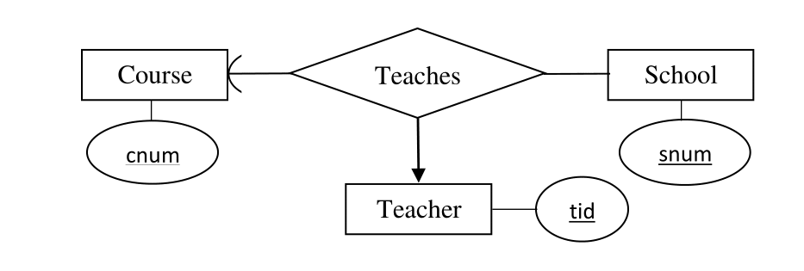
Database Management Systems (BCSC-0003)
Topic: E–R Diagrams
Nikhil Govil
Assistant Professor, Dept. of CEA, GLA University, Mathura.

Slide 2

E–R Diagram
E–R diagram stands for Entity Relationship Diagram.
Entity–relationship modeling was developed for database and design by Peter Chen in 1976.
An E–R diagram shows the relationship among entity sets.
An entity set is a group of similar entities and these entities can have attributes.
In terms of DBMS, an entity is a table.
By showing relationship among tables and their attributes, E–R diagram shows the complete logical structure of a database.

Slide 3
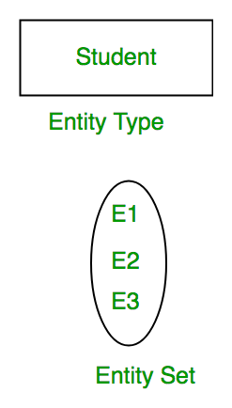
Introduction of E–R Model
ER Model is used to model the logical view of the system from data perspective which consists of these components:
Entity, Entity Type, Entity Set:
An Entity may be an object with a physical existence – a particular person, car, house, or employee – or it may be an object with a conceptual existence – a company, a job, or a university course.
An Entity is an object of Entity Type and set of all entities is called as entity set. e.g.; E1 is an entity having Entity Type Student and set of all students is called Entity Set. In ER diagram, Entity Type is represented as:

Slide 4
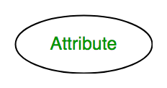
Introduction of E–R Model
Attribute:
Attributes are the properties which define the entity type. For example, Roll_No, Name, DOB, Age, Address, Mobile_No are the attributes which defines entity type Student. In ER diagram, attribute is represented by an oval.

Slide 5
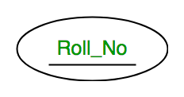
Introduction of E–R Model
1. Key Attribute –
The attribute which uniquely identifies each entity in the entity set is called key attribute. For example, Roll_No will be unique for each student. In ER diagram, key attribute is represented by an oval with underlying lines.

Slide 6
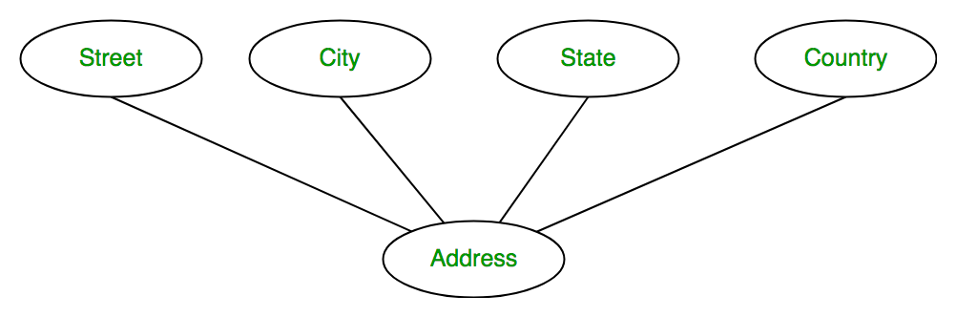
Introduction of E–R Model
2. Composite Attribute –
An attribute composed of many other attribute is called as composite attribute. For example, Address attribute of student Entity type consists of Street, City, State, and Country. In ER diagram, composite attribute is represented by an oval comprising of ovals.

Slide 7
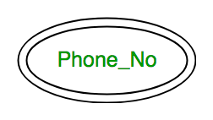
Introduction of E–R Model
3. Multivalued Attribute –
An attribute consisting more than one value for a given entity. For example, Phone_No (can be more than one for a given student). In ER diagram, multivalued attribute is represented by double oval.

Slide 8
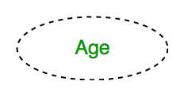
Introduction of E–R Model
4. Derived Attribute –
An attribute which can be derived from other attributes of the entity type is known as derived attribute. e.g.; Age (can be derived from DOB). In ER diagram, derived attribute is represented by dashed oval.

Slide 9
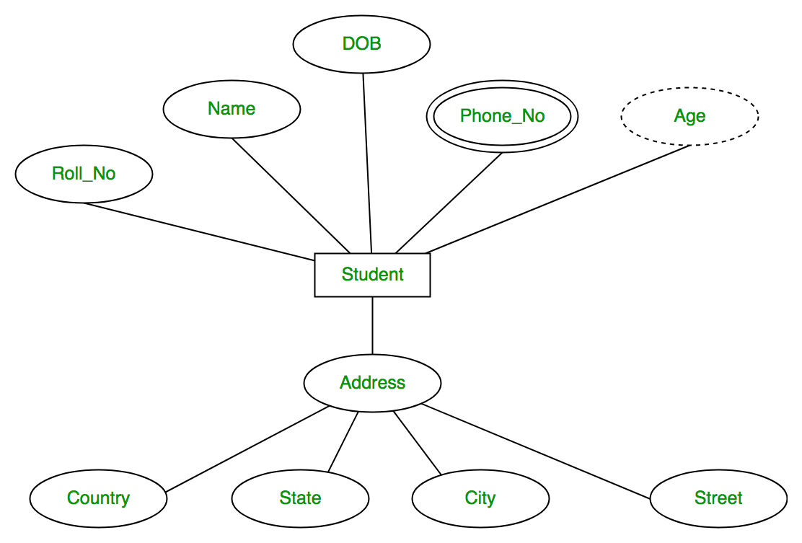
Introduction of E–R Model
The complete entity type Student with its attributes can be represented as:

Slide 10
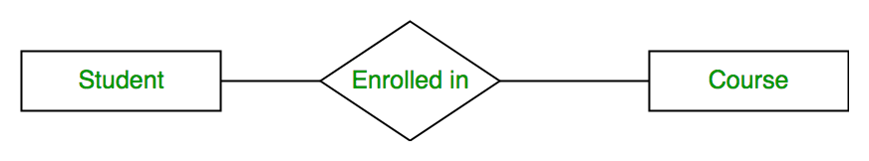
Introduction of E–R Model
Relationship Type and Relationship Set:
A relationship type represents the association between entity types. For example, ‘Enrolled in’ is a relationship type that exists between entity type Student and Course. In ER diagram, relationship type is represented by a diamond and connecting the entities with lines.

Slide 11
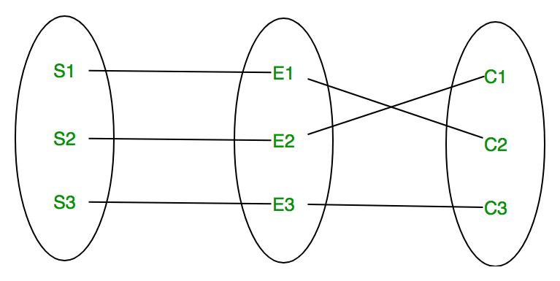
Introduction of E–R Model
A set of relationships of same type is known as relationship set. The following relationship set depicts S1 is enrolled in C2, S2 is enrolled in C1 and S3 is enrolled in C3.

Slide 12
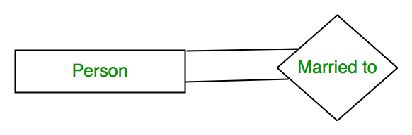
Introduction of E–R Model
Degree of a relationship set:
The number of different entity sets participating in a relationship set is called as degree of a relationship set.
1. Unary Relationship –
When there is only ONE entity set participating in a relation, the relationship is called as unary relationship. For example, one person is married to only one person.

Slide 13
Introduction of E–R Model
2. Binary Relationship –
When there are TWO entities set participating in a relation, the relationship is called as binary relationship. For example, Student is enrolled in Course.

Slide 14
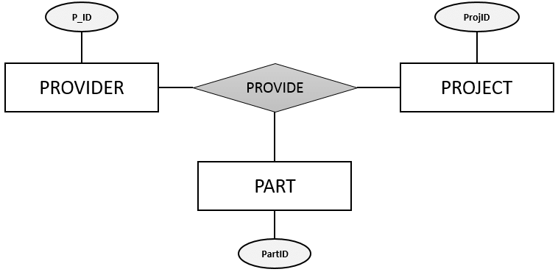
Introduction of E–R Model
3. n-ary Relationship –
When there are n entities set participating in a relation, the relationship is called as n-ary relationship.
Cardinality:
The number of times an entity of an entity set participates in a relationship set is known as cardinality. Cardinality can be of different types as:
A. One to One Relationship
B. One to Many Relationship
C. Many to One Relationship &
D. Many to Many Relationship

Slide 15
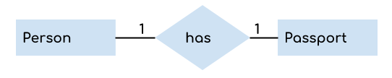
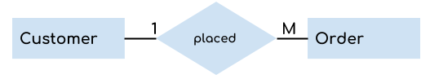
Introduction of E–R Model
A. One to One Relationship – When a single instance of an entity is associated with a single instance of another entity then it is called one to one relationship. For example, a person has only one passport and a passport is given to one person.
B. One to Many Relationship – When a single instance of an entity is associated with more than one instances of another entity then it is called one to many relationship. For example – a customer can place many orders but a order cannot be placed by many customers.

Slide 16
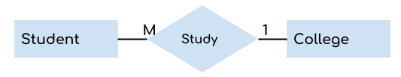
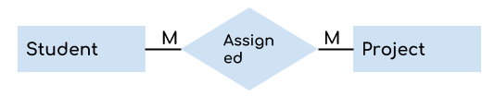
Introduction of E–R Model
C. Many to One Relationship – When more than one instances of an entity is associated with a single instance of another entity then it is called many to one relationship. For example – many students can study in a single college but a student cannot study in many colleges at the same time.
D. Many to Many Relationship – When more than one instances of an entity is associated with more than one instances of another entity then it is called many to many relationship. For example, a student can be assigned to many projects and a project can be assigned to many students.

Slide 17
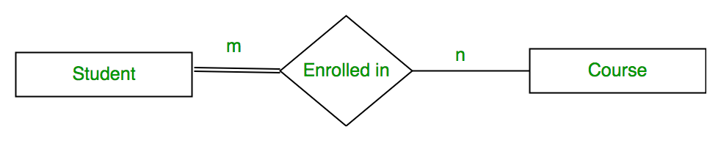
Introduction of E–R Model
Participation Constraint:
Participation Constraint is applied on the entity participating in the relationship set.
Total Participation – Each entity in the entity set must participate in the relationship. If each student must enroll in a course, the participation of student will be total. Total participation is shown by double line in ER diagram.
Partial Participation – The entity in the entity set may or may NOT participate in the relationship. If some courses are not enrolled by any of the student, the participation of course will be partial.
The diagram depicts the ‘Enrolled in’ relationship set with Student Entity set having total participation and Course Entity set having partial participation.

Slide 18
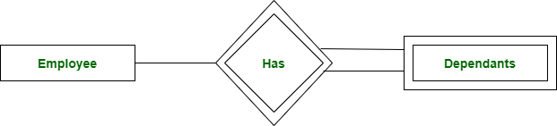
Introduction of E–R Model
Weak Entity Type and Identifying Relationship:
As discussed before, an entity type has a key attribute which uniquely identifies each entity in the entity set. But there exists some entity type for which key attribute can’t be defined. These are called Weak Entity type.
For example, A company may store the information of dependants (Parents, Children, Spouse) of an Employee. But the dependents don’t have existence without the employee. So Dependent will be weak entity type and Employee will be Identifying Entity type for Dependant.
A weak entity type is represented by a double rectangle. The participation of weak entity type is always total. The relationship between weak entity type and its identifying strong entity type is called identifying relationship and it is represented by double diamond.

Slide 19
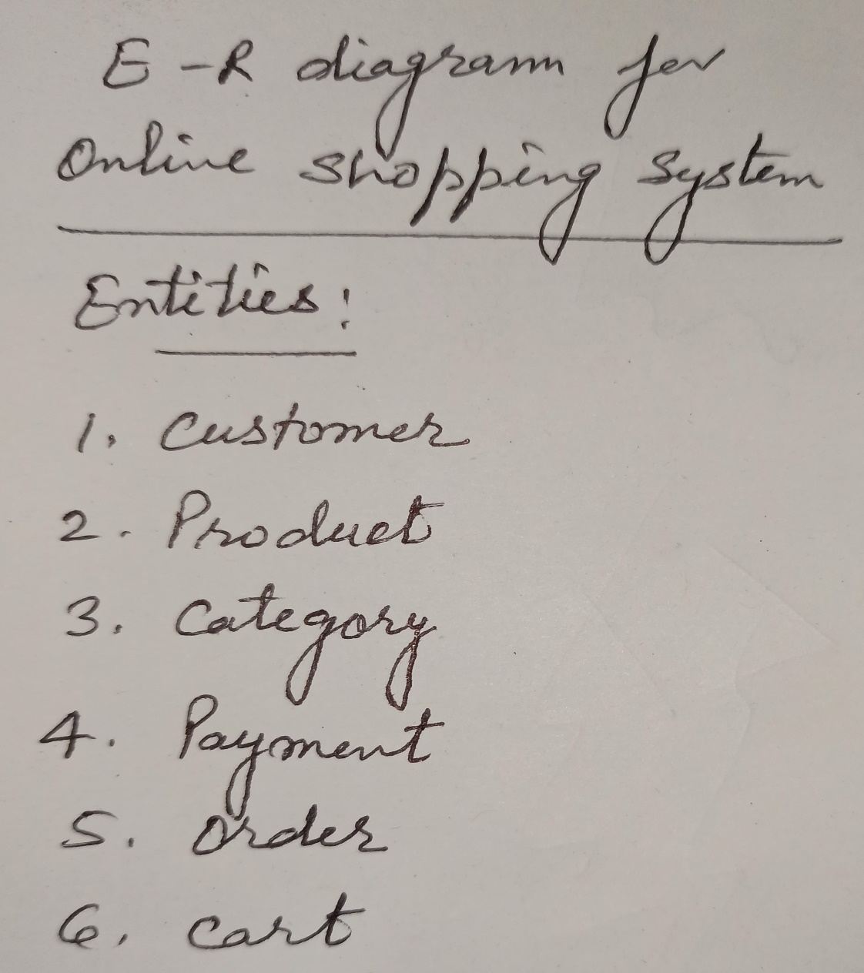
E–R Diagram for Online Shopping System

Slide 20
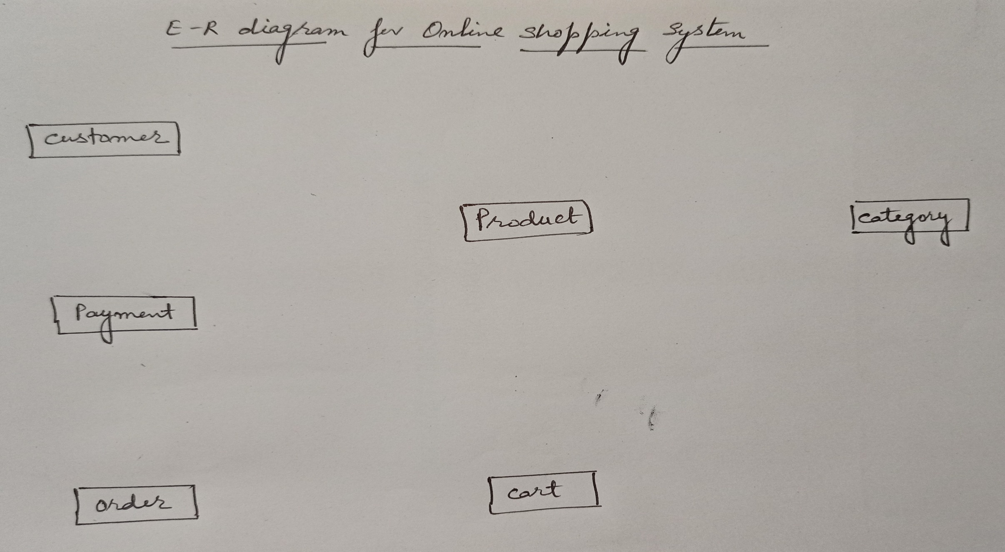
E–R Diagram for Online Shopping System

Slide 21
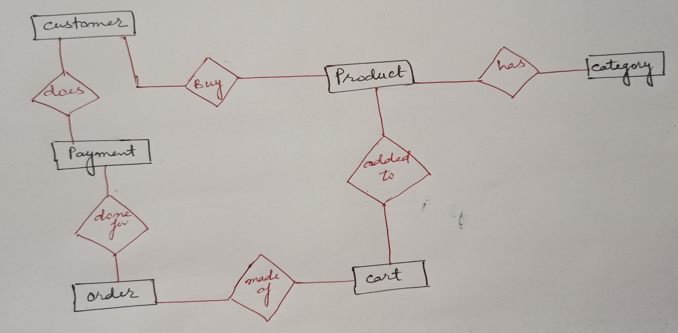
E–R Diagram for Online Shopping System

Slide 22
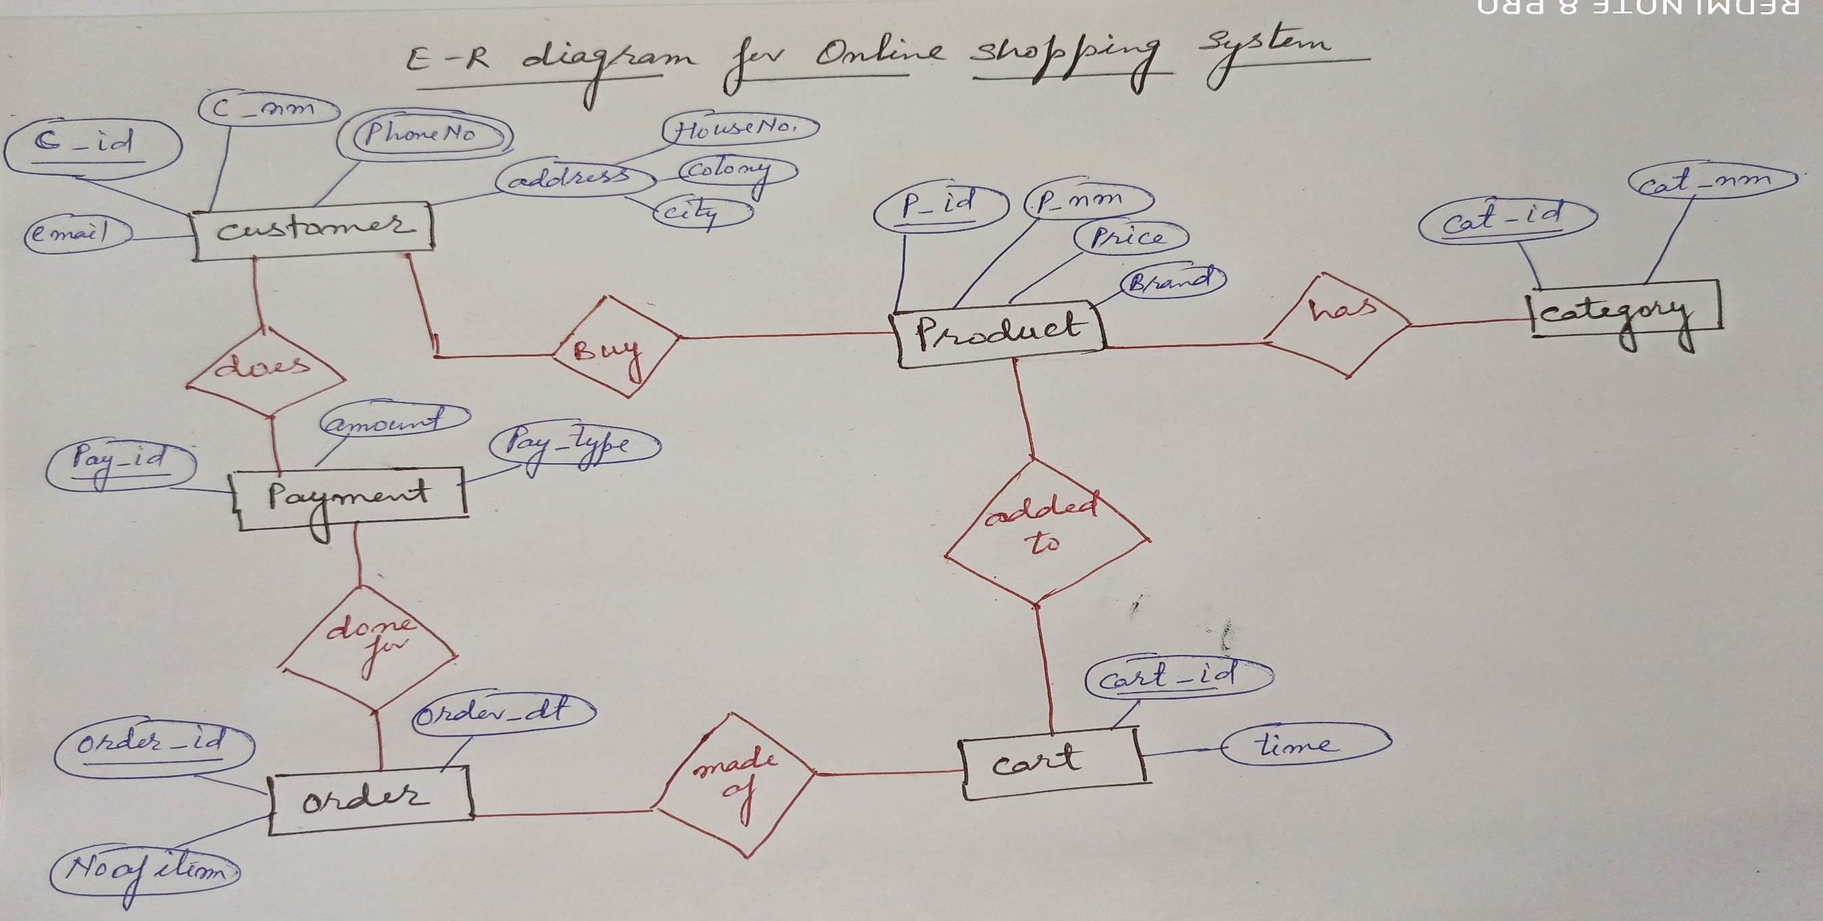
E–R Diagram for Online Shopping System

Slide 23
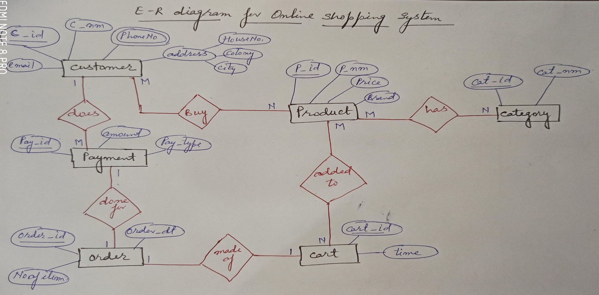
E–R Diagram for Online Shopping System

Slide 24
References
Korth, Silbertz and Sudarshan (1998), “Database Concepts”, 4th Edition, TMH.
Elmasri and Navathe (2010), “Fundamentals of Database Systems”, 5th Edition, Addision Wesley.
Date C J,” An Introduction to Database Systems”, 8th Edition, Addision Wesley.
M. Tamer Oezsu, Patrick Valduriez (2011). “Principles of Distributed Database Systems”, 2nd Edition, Prentice Hall.

Slide 25


